Slide 1
RTX-Explore
DXR Path Tracer
Liam Dugan · Henry Zhu · Ziad Ben Hadj-Alouane

Slide 2
Current Progress

Slide 3
MILESTONE I - Part 1
Ray tracing pipeline
Object Loading
Textures
Normal mapping

Slide 4


Slide 5
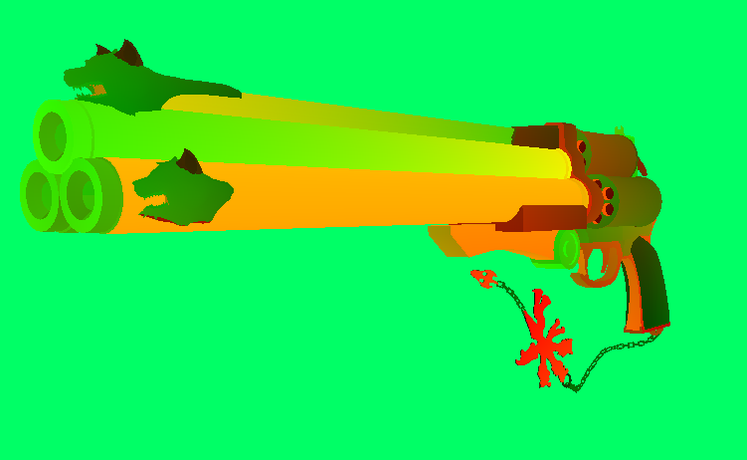
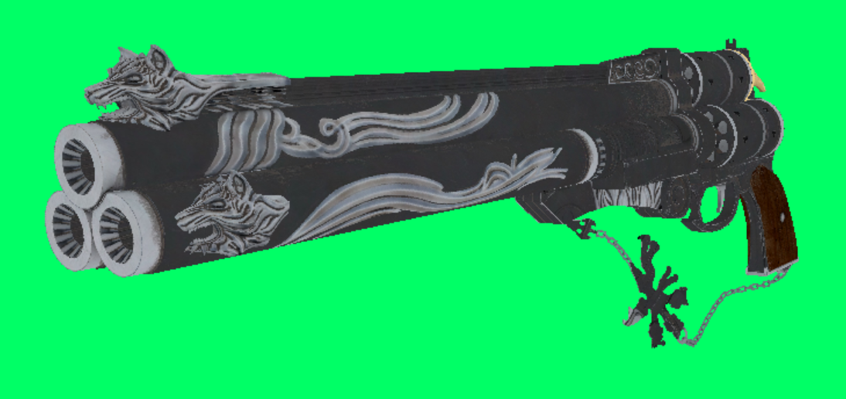

Slide 7
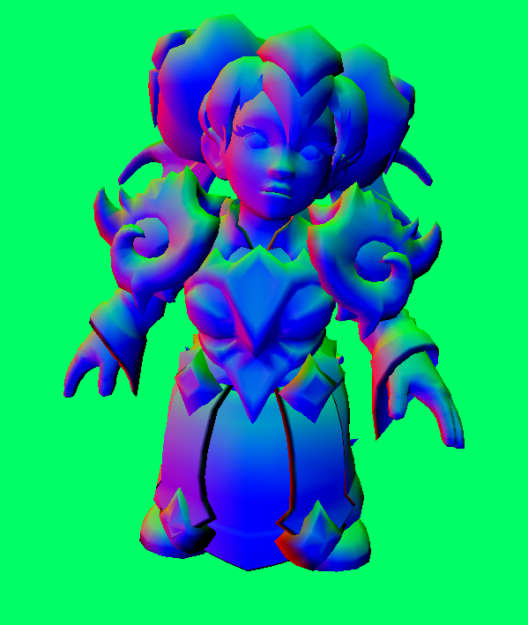

Slide 8
MILESTONE I - Part 2
Basic Raytracing Setup
Fallback layer
Acceleration structure

Slide 9
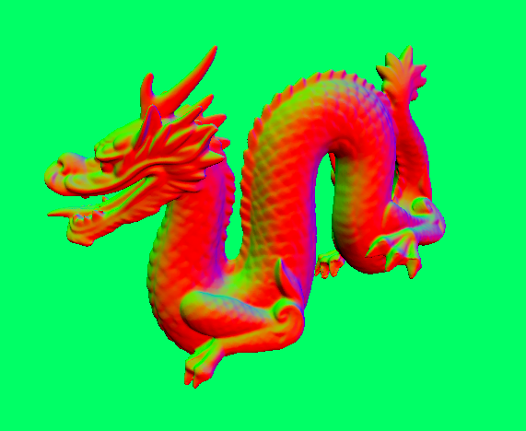

Slide 11
MILESTONE I - Part 3
Debugger Setup with Fallback layer

Slide 12
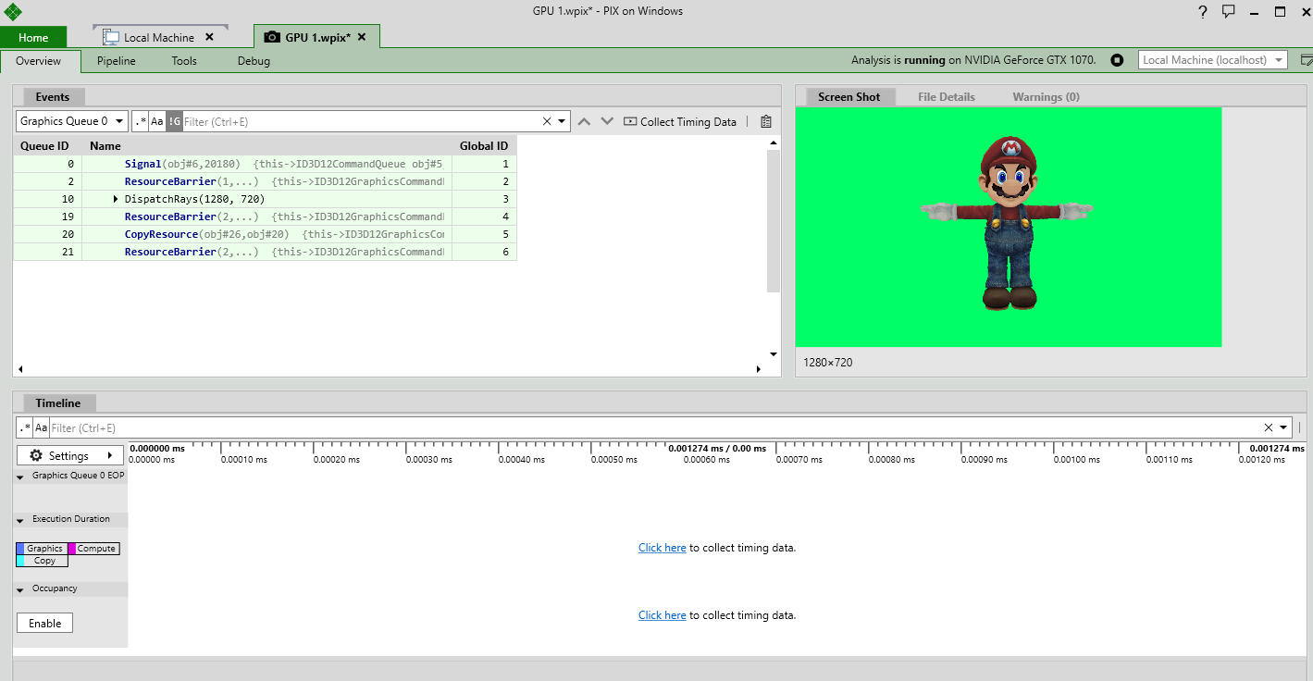

Slide 13
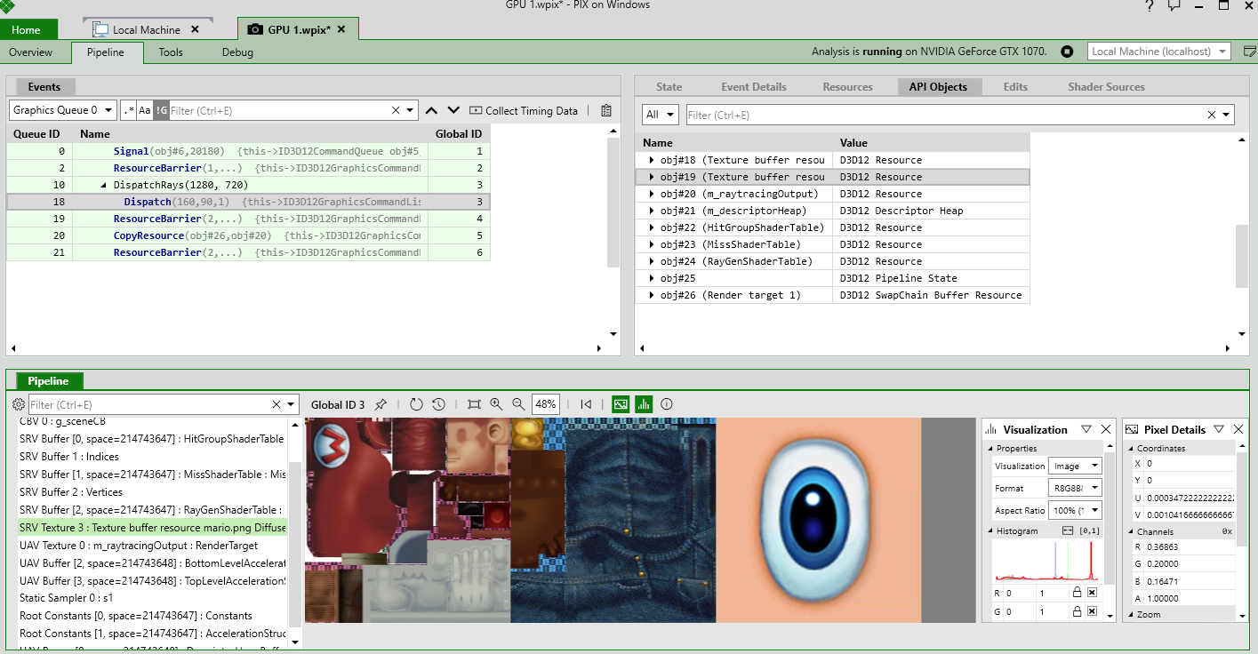

Slide 14
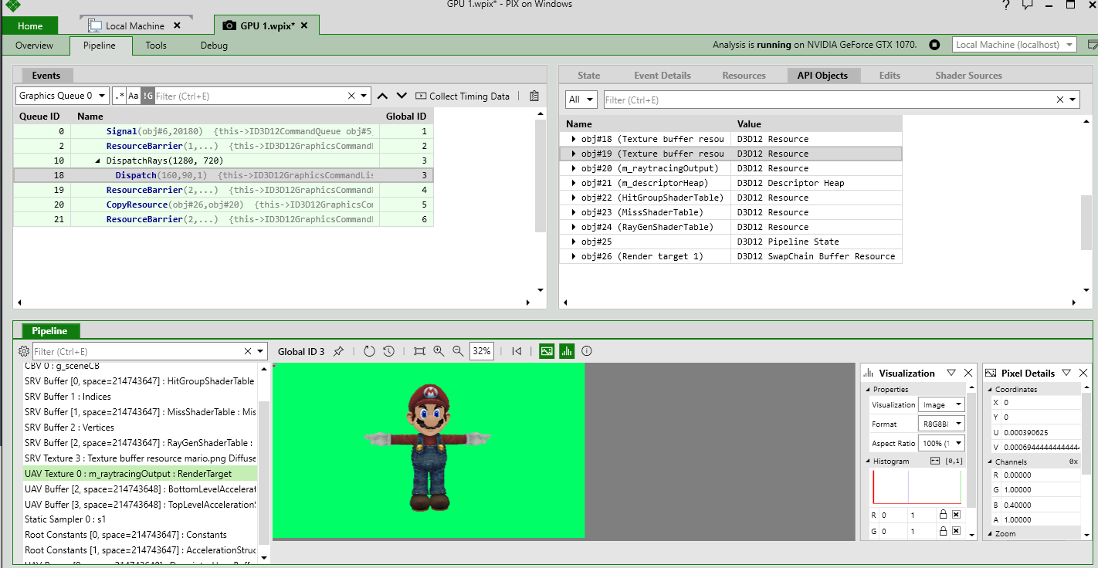

Slide 15
Upcoming Goals

Slide 16
MILESTONE II
Path Tracing set up
Scene loading
Diffuse/specular shading
AA & DOF

Slide 17
MILESTONE III
Fresnel & Schlick
Dispersion
Subsurface scattering
Other cool effects
Another application of raytracing (?)

